Slide 1

Relationship between sleep disturbances and dementia
Le Shi
Peking University Sixth Hospital

Slide 2
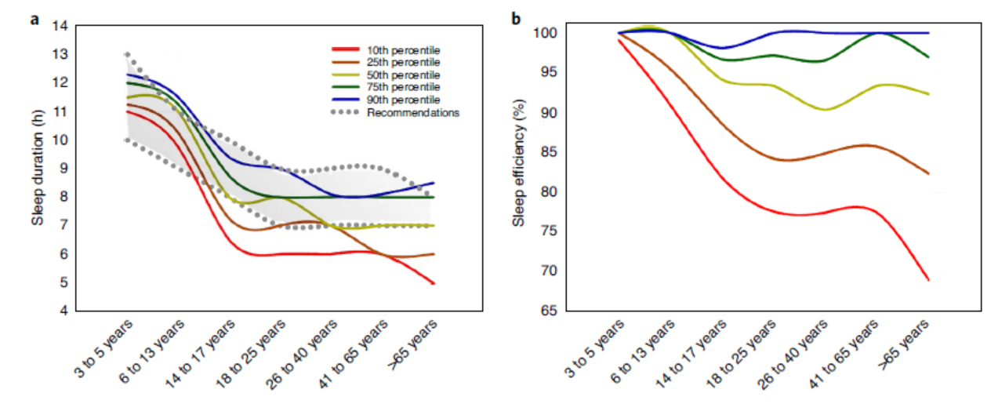
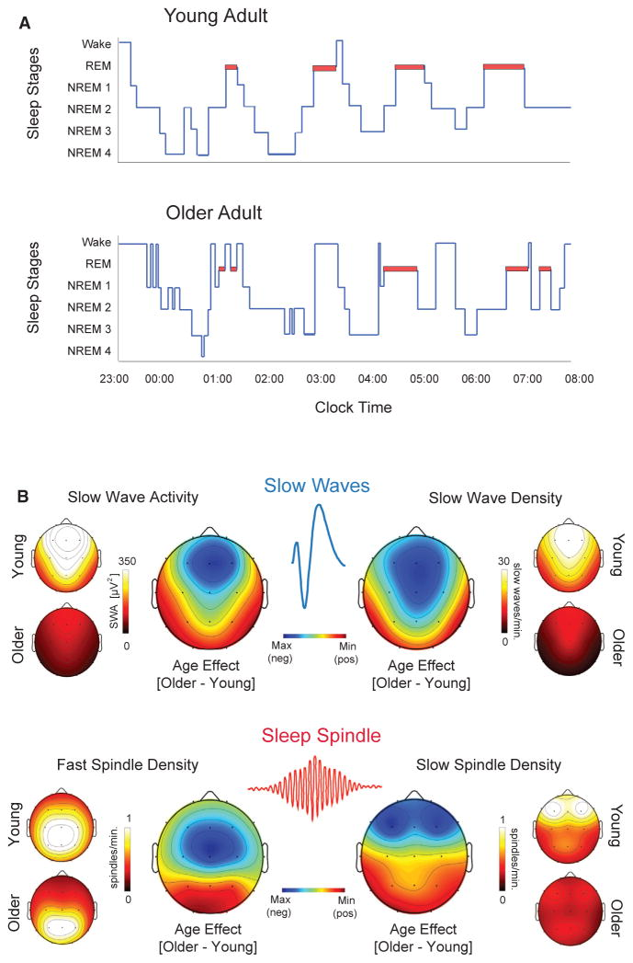
Sleep Characteristics Across the Ages
Kocevska et al., Nat Hum Behav 2021; Mander et al., Neuron 2017

Slide 3
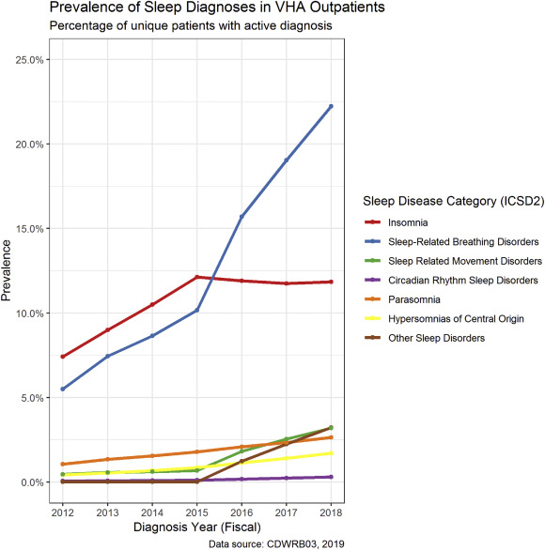
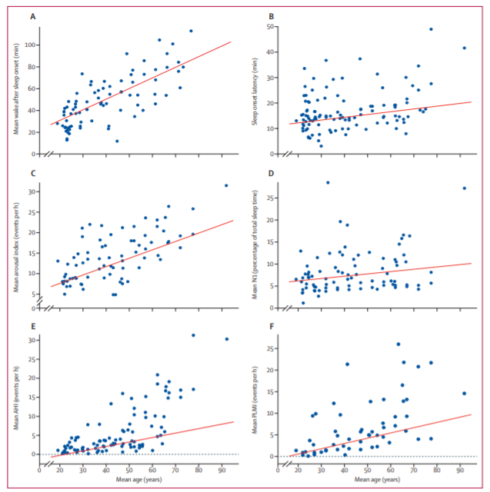
Sleep Disturbances
Wake after sleep onset
Sleep onset latency
Arousal index
N1 percentage
Apnea hypopnea index
Periodic limb movement index
Folmer et al., Sleep Med Rev 2020; Boulos et al., Lancet Respir Med 2019

Slide 4
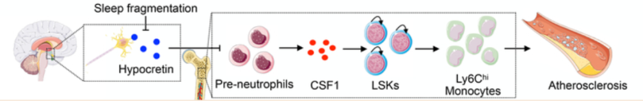
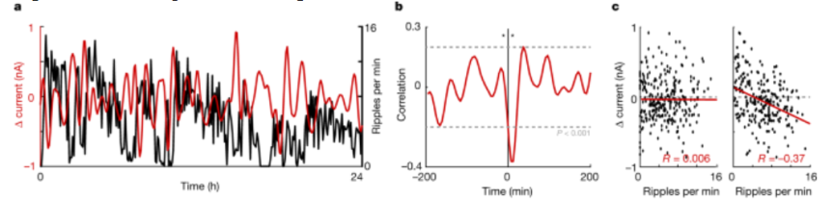
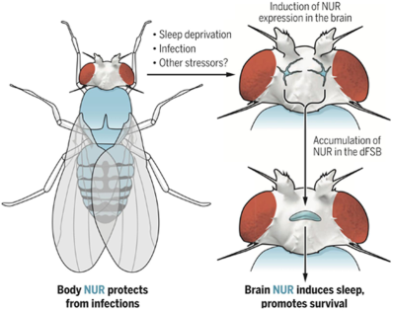
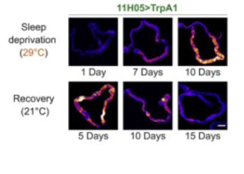
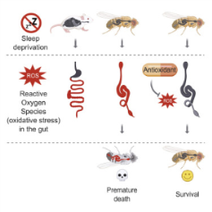
Sleep Disturbances and Health Outcomes
Cardiovascular Diseases
Metabolic Diseases
Sleep regulates haematopoiesis and protects against atherosclerosis
A function of the sharp wave-ripple is to modulate peripheral glucose homeostasis
Mcalpine et al., Nature 2019
Tingley et al., Nature 2021
Immune Diseases
Death
Sleep loss can cause death through accumulation of reactive oxygen species in the gut
The NEMURI protein can drive prolonged sleep and to promote survival after infection
Toda et al., Science 2019
Vaccaro et al., Cell 2020
4

Slide 5

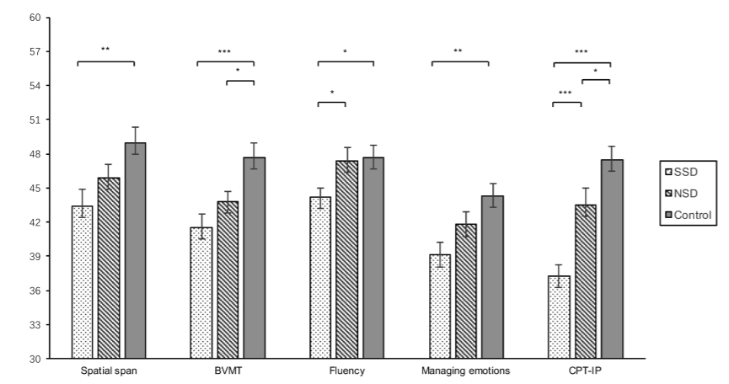
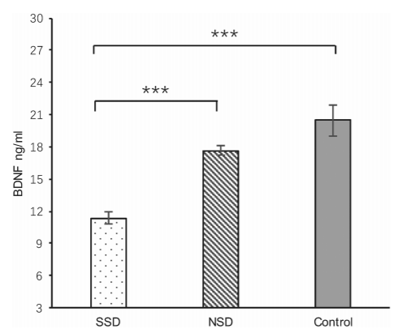
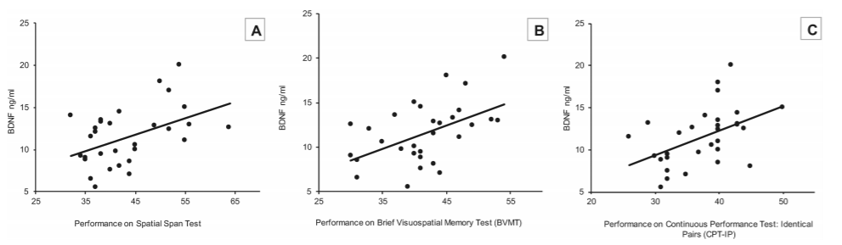
Sleep Disturbances and Cognitive Impairment
Prof. Lin Lu
Peking University Sixth Hospital
Fan et al., Sleep 2019

Slide 6
Sleep Disturbances and Dementia
Some studies have reported that insomnia and sleep disordered breathing increase the risk of developing dementia, but others reported that delays in sleep onset, difficulty maintaining sleep, early morning awakening, snoring, and sleep apnea do not increase the risk of incident dementia
A comprehensive examination of the predictive role of sleep disturbances in incident dementia is lacking
Yaffe et al., JAMA 2011; Yaffe et al., Am J Geriatr Psychiatry 2015;
Bokenberger et al., J Gerontol A Biol Sci Med Sci 2017; Lutsey et al., Alzheimers Dement 2018

Slide 7
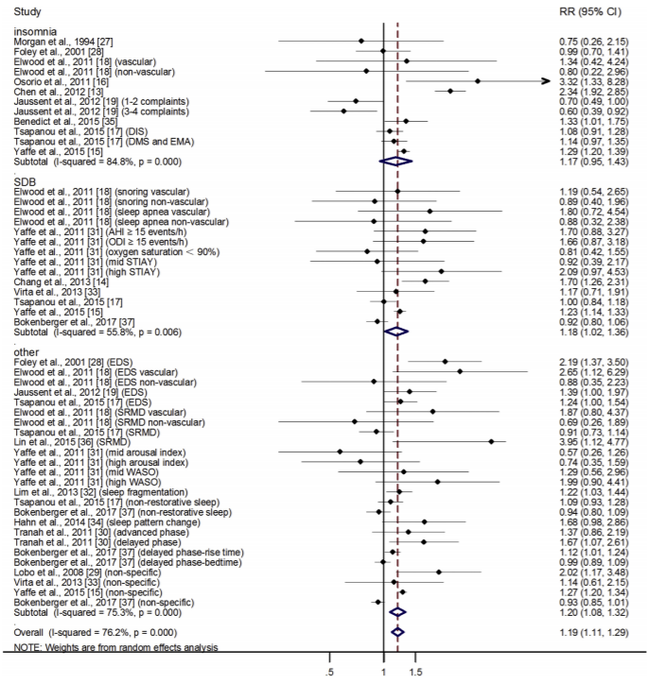
Meta of Sleep Disturbances and Dementia
All-cause dementia
Eighteen longitudinal studies that included 246,786 subjects at baseline and 25,847 dementia cases after an average 9.49 y of follow-up were eligible for inclusion
Insomnia
Sleep disordered breathing
Shi et al., Sleep Med Rev 2018

Slide 8
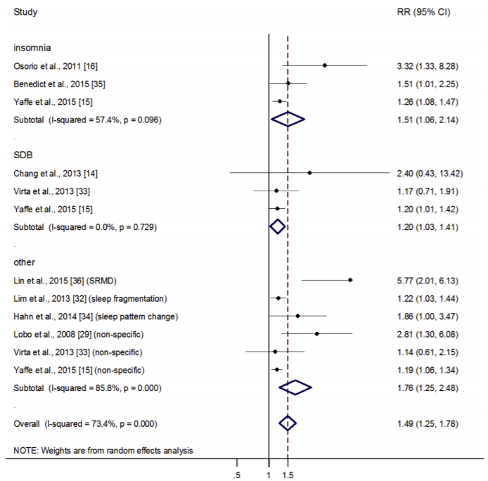
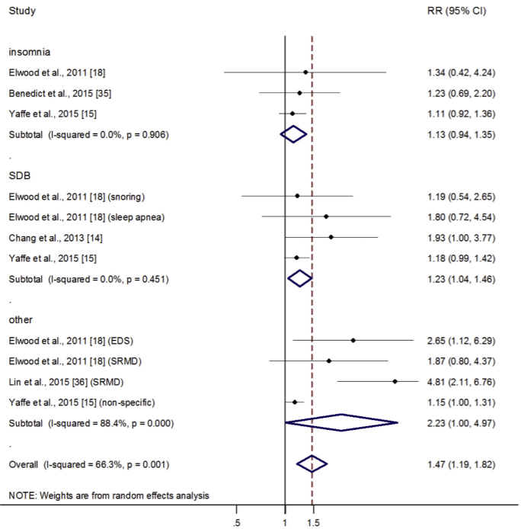
Meta of Sleep Disturbances and Dementia
Alzheimer's disease
Vascular dementia
Insomnia
Insomnia
Sleep disordered breathing
Sleep disordered breathing
Shi et al., Sleep Med Rev 2018

Slide 9
Meta of Sleep Disturbances and Dementia
 | All-cause dementia | Alzheimer's disease | Vascular dementia
Sleep disturbances | ↑ | ↑ | ↑
Insomnia | -- | ↑ | --
Sleep disordered breathing | ↑ | ↑ | ↑
Shi et al., Sleep Med Rev 2018

Slide 10
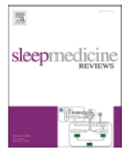
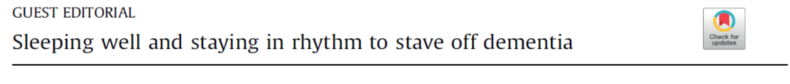
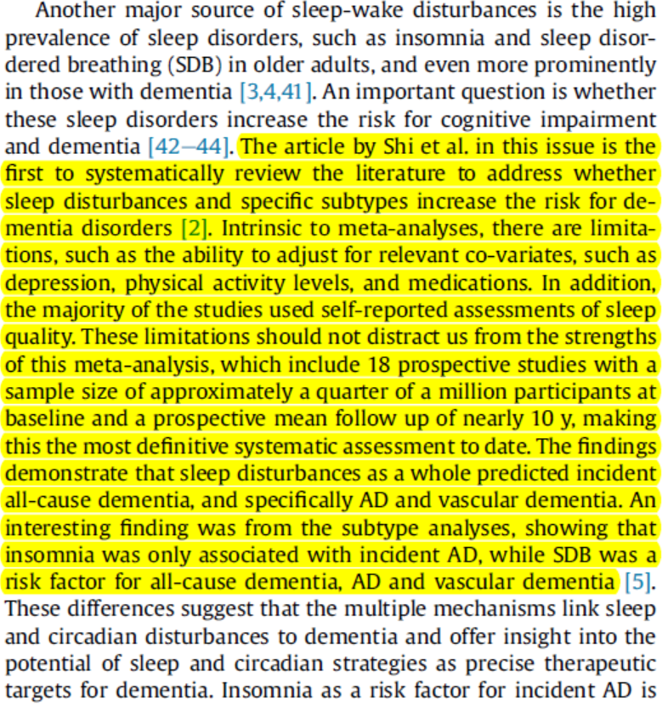


Comment on Meta of Sleep Disturbances and Dementia
Prof. Phyllis C Zee
Northwestern University
Prof. Roneil G Malkani
Northwestern University
Malkani and Zee, Sleep Med Rev 2018

Slide 11

Sleep Disturbances and Amyloid
As a biomarker for dementia, detecting amyloid (Aβ) in cognitively normal older adults has clinical implications for the prevention and intervention of cognitive decline and dementia in the early stage
The relationship between sleep disturbances and Aβ is unclear

Slide 12
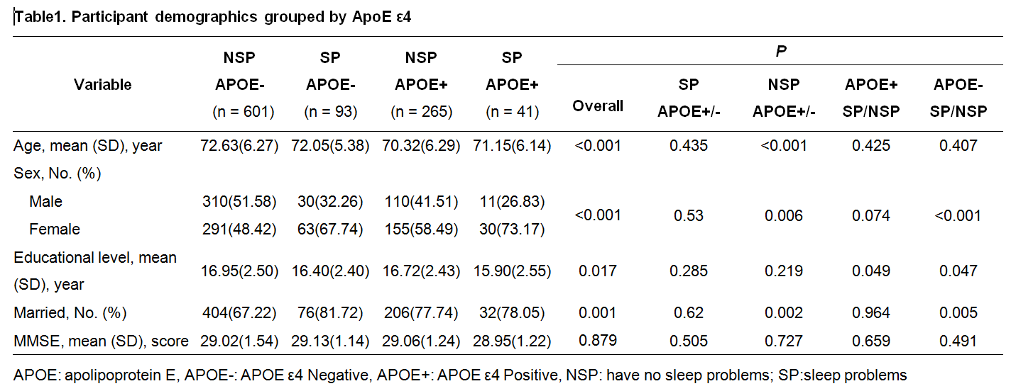
Sleep Disturbances and Amyloid
This cross-sectional study obtained data from the Alzheimer's Disease Neuroimaging Initiative (ADNI) database
The 1000 cognitively normal participants with a mean (SD) age of 71.9 (6.26) years and 53.9% female were included in this study
Unpublished data

Slide 13
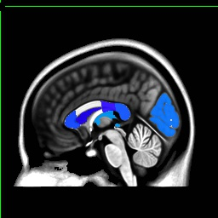
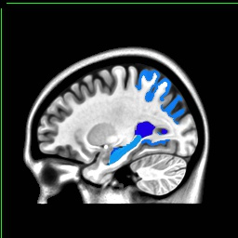
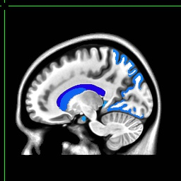
Sleep Disturbances and Amyloid
Sleep problems were not associated with brain Aβ burden among all participants
We performed a subgroup analysis by the presence of the APOE ε4
Effects of sleep problems on regional differences in Aβ in the APOE ε4+ group. The regions include left bankssts, left cuneus, bilateral entorhinal, left lingual, left superior parietal, left hippocampus, and many other brain regions
Unpublished data

Slide 14
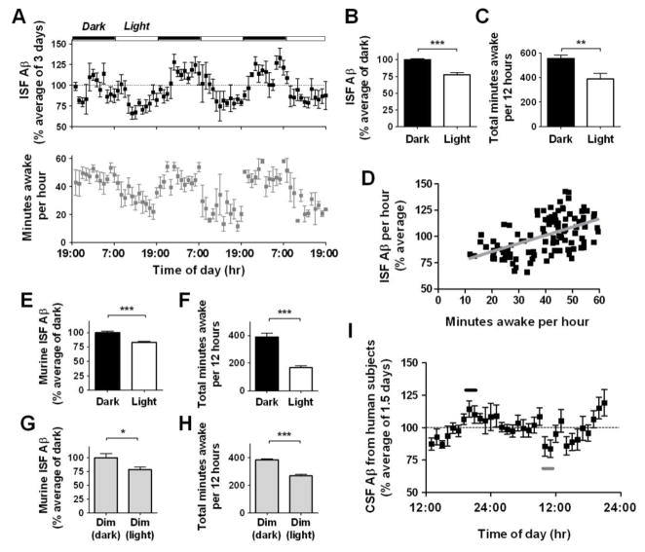
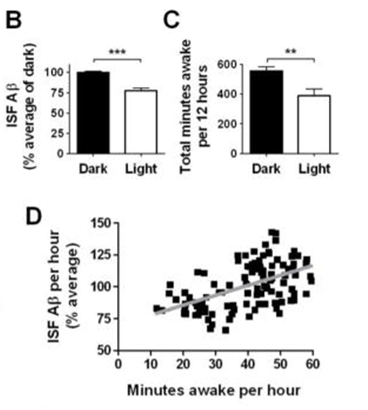

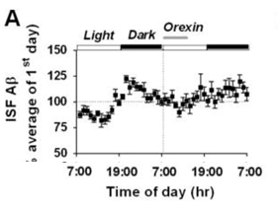
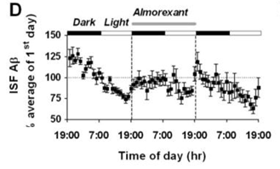
Aβ Dynamics are Regulated by Sleep-Wake Cycle
Humans
Mice
The amount of brain interstitial fluid Aβ correlated with wakefulness
Prof. David M. Holtzman
Washington University
Kang et al., Science 2009

Slide 15

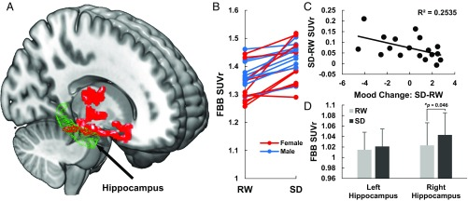
Brain Aβ Increases After Sleep Deprivation
One night of sleep deprivation, relative to baseline, resulted in a significant increase in Aβ burden in the right hippocampus and thalamus
Prof. Nora D. Volkow
National Institute on Alcohol Abuse and Alcoholism
Shokri-Kojori et al., PNAS 2018

Slide 16
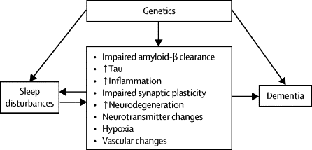
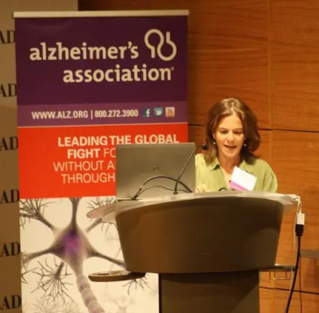
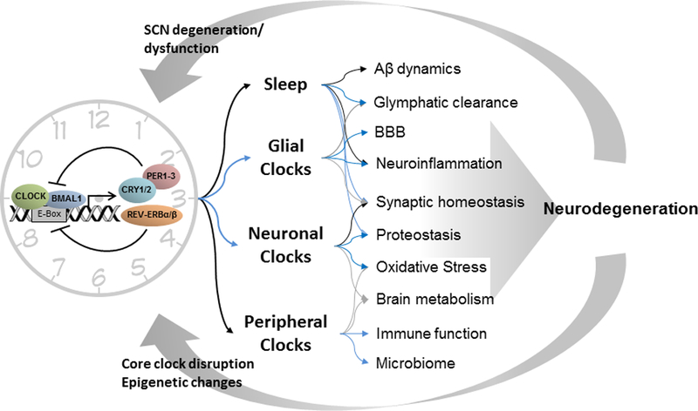
Other Potential Mechanisms of Sleep Disturbances and Dementia
Prof. Kristine Yaffe
University of California San Francisco
https://yaffe.ucsf.edu/
Yaffe et al., Lancet Neurol 2014; Leng et al., Lancet Neurol 2019

Slide 17
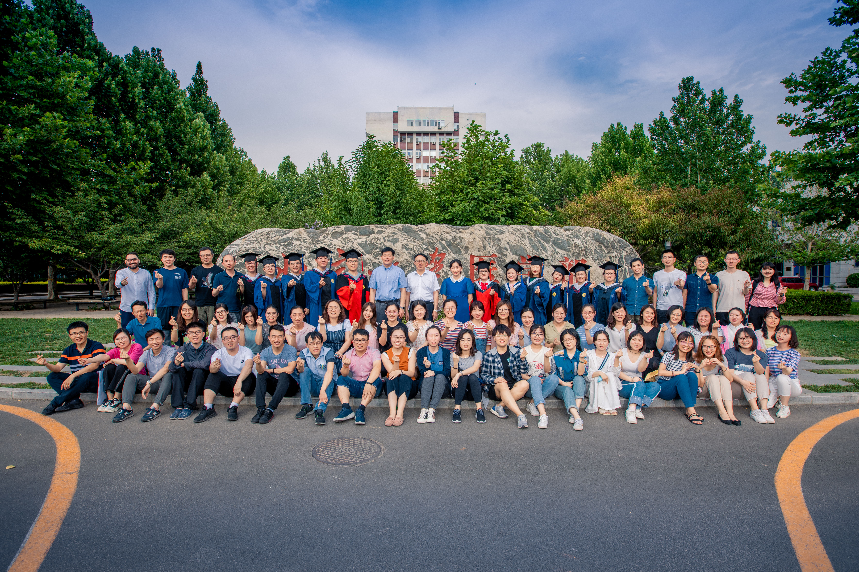
Acknowledgement
Prof. Lu Lin, Prof. Shi Jie, Prof. Sun Hong-Qiang
Bao Yan-Ping, Deng Jia-Hui, Que Jian-Yu, Zheng Yong-Bo, Wang Qian-Wen, Feng Shu-Fei
Wu Ping, Chang Su-Hua, Han Ying, Yan Wei, Sun Yan-Kun, Yuan Kai

Slide 18
Thank you!
Q and A

